Slide 1




Variety Child Learning Center
Parent Orientation
2024-2025

Slide 2

Welcome
Welcome to Variety Child Learning Center!
We are very excited that your child is attending our program.
We are very excited to welcome all of you.

Slide 3
Tonight's Speakers
Anna Cicciari
Syosset Principal
Stacey Trotti
Assistant Director of Family Services

Slide 4

Mission and Core Values
VCLC is committed to providing high quality programs for young children with disabilities and their families that focus on the educational, social-emotional and physical growth of the children, and home/school collaboration.
Notes:
Anna

Slide 5
If you have not returned the packet with your medical, prescriptions, permission slips, etc.
Please do So now!!!
Your Child's services cannot start without the MEDICAL, Prescriptions and a finalized IEP.
Notes:
Anna

Slide 6
Sign-up for ALERT NOW TO KEEP YOU Abreast OF IMPORTANT INFORMATION QUICKLY.
Please fill out your Alert now sheets ASAP.
They can be emailed to skennedy@vclc.org
Or faxed to 516-368-8308
Notes:
Anna

Slide 7
Notes:
Anna

Slide 8
Beginnings
Separation
Trust
Adjustments
Everyone is coming from a different place – some are new to our program –some are transitioning from EI – some from other programs.
Building trust between students and teachers, and families and school.
New surroundings, new sounds, new voices, new toys, new expectations
Notes:
Stacey

Slide 9

attendance
Attendance is taken every day.
If your child is going to be absent call the attendance office at 516-921-7171 follow the prompts for your location. Do not call your social worker or classroom teacher if your child is going to be absent.
If your child takes the bus also call the bus company and tell them your child will not be going to school (the bus company opens at 7:00 AM).
Notes:
Anna

Slide 10
Health and Medical
According to NYSDOH/NYSED children who have a temperature of 100.4 or greater must stay home from school. If sent home from school with a fever, child must stay home until fever free without the use of fever reducers for at least 24 hours.
Pick-up protocol: You must be able to come pick up your child within an hour of being called. If you are unable, someone on your emergency contact list must be available to pick up your child in a timely manner.
Notes:
Laurie

Slide 11
What can families do to support health and safety in the school environment?
Monitor your child's symptoms at home. If your child has a fever of 100. 4 or above, they will be sent home. Be proactive and take temperatures before leaving for school.
Practice hand washing and using hand sanitizer at home.
Submit an Alert Now form before school starts. This will keep you up to date with emergency procedures.
Make sure emergency contacts listed on your form can drive and are available to pick up a child in under an hour if needed.
Notes:
Laurie

Slide 12
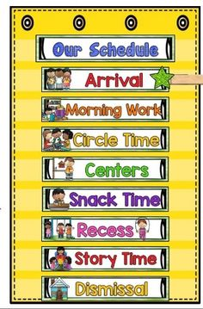
What does a school day look like?
Structured Play / Activity Centers
Circle
Movement
Learning Times
Breakfast/Snack/Lunch
Art/Sensory
Gross Motor – Outdoor Play /Gym Time
Specials- Dance/Movement Therapy, Music Therapy,
Art Therapy, Computers
Notes:
Anna
ITT for ABA classes

Slide 13
Related services
Occupational Therapy: School based OT’s focus on helping a child reach their full potential to participate in their “occupation” (being a student). Benefits of OT include improving fine-motor skills, visual perception, eye-hand coordination, body awareness, cognitive skills, and sensory processing.
Speech Therapy: Children will engage in a variety of activities to assist in the development of their speech and language. Therapy focuses on increasing communication across all environments (e.g., home, school, and community) while targeting IEP goals. Collaboration between family, therapists, and classroom staff plays a key role in a child’s success.
Physical Therapy: School based PT’s provide services to children who present with physical needs or disabilities that impact their ability to safely navigate their school environment and efficiently keep up with their peers. Benefits of PT include improving muscle strength, joint motion, balance, coordination, endurance and overall gross motor development.
Parent Training: Parent training and counseling, provided by the social workers focuses on the parents/caregivers working collaboratively with the assigned social worker to identify goals related to the child’s needs at home and to provide strategies, education, and support to achieve those goals and to assist with carryover of skills from school to home.
Child Counseling: Child psychological counseling, also referred to as play therapy is a service that is provided by the social workers and focuses on a child’s social/emotional function and behaviors and may be indicated when issues persist that interfere with the child’s coping, adaptation and ego development at school or home.
Notes:
Stacey

Slide 14

“Back to school" night
This will be a time where your teachers will go into greater detail about your child's day!!!
A portion of the evening will be dedicated to meeting your child's therapist(s)s!
More details to come!
Your classroom teacher will go into detail concerning:
  Curriculum
  Social Emotional Development
  Daily schedules
  Family/classroom collaboration
  Information on Parent/Teacher Conferences will be forthcoming
Notes:
Anna

Slide 15

General Information
Children will be engaged in a wide variety of activities:
  Dress comfortably
  Change of clothing
  Diapers
  Sneakers are preferred
Notes:
Anna

Slide 16

Communication
Teachers will communicate on a regular basis. Home school collaboration is the key to the success of the child.
  Notebooks, newsletters, chat through Seesaw, phone calls, email (with consent) can be used
Please check your child’s backpack daily for important information.
Utilize your social worker!
Notes:
Stacey

Slide 17
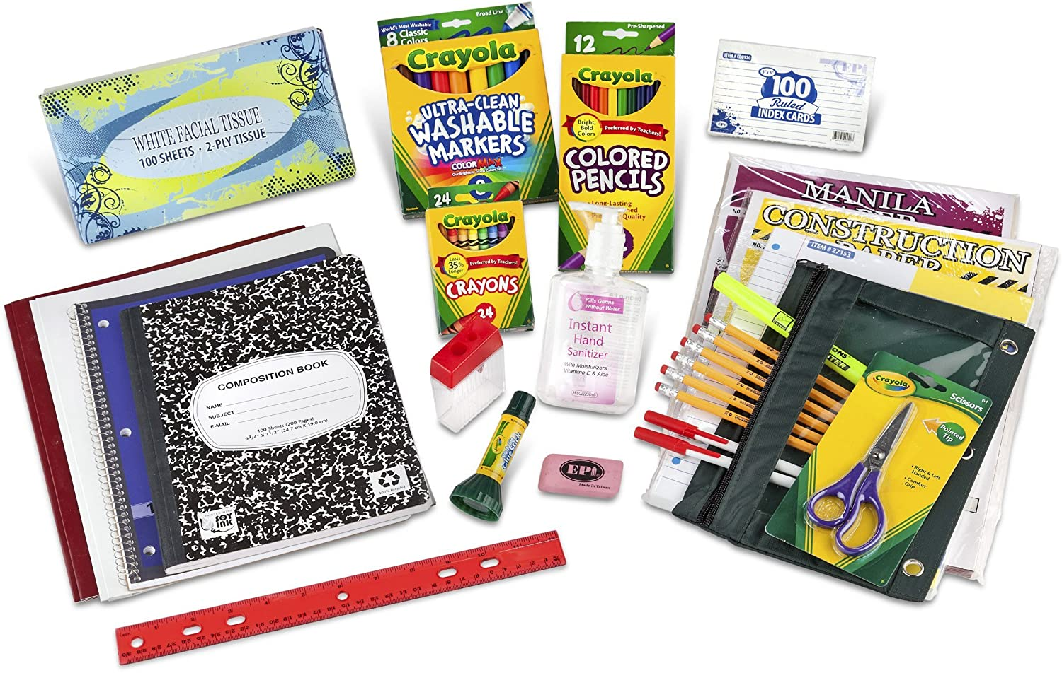
Classroom supplies
Each month your teacher may send home a request for needed supplies or a donation which is optional but greatly appreciated ☺
Your teacher will discuss this more with you at back-to-school night.
Requests will vary from month to month!
Notes:
Anna

Slide 18

Confidentiality
All staff at VCLC are well trained in confidentiality practices.
We are mindful of where and when we talk about the children; their progress, goals, and individual needs.
Notes:
Stacey

Slide 19


Classroom Mealtimes
How should you pack your child's snacks and lunch?
  All food must come in insulated lunch bags with ice packs for food/drinks that must stay cold.
  We cannot heat food, anything sent in must be served the way it comes in.
  We are a nut free school, please check the labels of all food you are sending in.
  No communal snacks
  Send a nutritional lunch
Notes:
Anna

Slide 20


Family Events
Families are invited to several events throughout the school year.
  “VIP” days
  There is an end-of-year “moving up” ceremony for pre-school classes
  If requested parents or a special person can come in for an end-of-the-day birthday celebration
Notes:
Anna

Slide 21
Emergency Drills
VCLC will comply with all SED and OCFS requirements to conduct evacuation drills including fire, lockout and lockdown drills throughout the school year. OCFS regulations require a minimum of one fire drill per month. SED requires a minimum of 12 drills per year, 8 of which must be held prior to December 31st .
VCLC will continue to provide different scenarios during these drills so that staff and students practice using a variety of exits in case a fire blocks the primary exit route.
Evacuation drill procedures will be modified to include the following precautions:
  Lockout and Lockdown drills will be completed at a minimum of twice yearly for each group.
  In an emergency, students and staff will exit the building as quickly as possible and follow instructions from emergency.
  Assembly areas will be marked with class designations which keep the groups a minimum of 6 feet apart.
  Emergency bags that are taken outside for each drill will also include extra adult and children’s face masks.
Notes:
Anna

Slide 22

Parent Education and Training
At VCLC we have a home/school collaborative model, each family is connected to a social worker who is the liaison between home and school. The role of the social worker is to provide parent training, present workshops and facilitate parent support groups.
  If you have any questions or concerns regarding your child's classroom or related services, please reach out to your social worker.
Notes:
Stacey

Slide 23

FAMILY Association
  Role of the Family Association:
      We have fundraising events and other activities for our children and families both in school and in the community.
      We meet monthly to plan events.
      Watch for details about how you can become member of the Family Association.
Notes:
Stacey

Slide 24
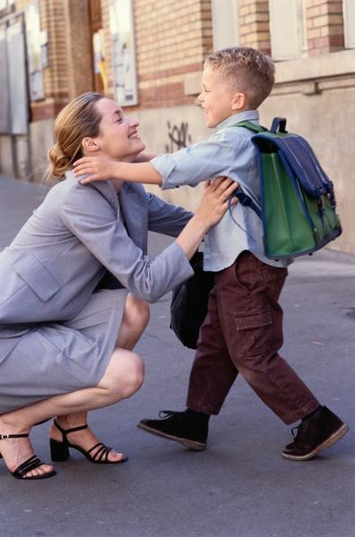

Provide the best care, welfare, safety and security
Sign in & Sign out procedures
Building Access
Picture Identification
Notes:
Anna

Slide 25

Health & Medical Information
Syosset, Laurie Librizzi: 516-921-7171 ext. 2110
llibrizzi@vclc.org
Notes:
Anna

Slide 26
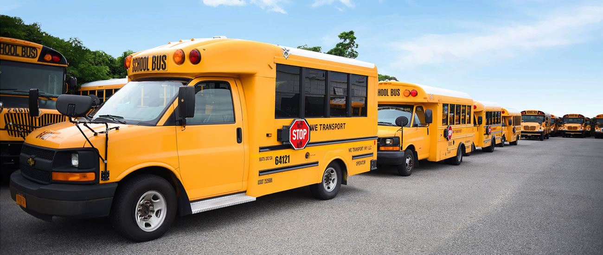
Transportation
Syosset, Amanda Schnorr: 516-921-7171 ext. 2189
aschnorr@vclc.org
Notes:
Anna

Slide 27
Social Media
www.varietyclc.org
FACEBOOK
Notes:
Anna

Slide 28
Thank You!
Contacts
  Anna Cicciari: Principal – Syosset – acicciari@vclc.org
        516-921-7171 Ext. 2201
  Stacey Trotti: Assistant Director of Family Services– strotti@vclc.org
        516-921-7171 Ext. 2184
Stay Safe and well!
Notes:
Stacey

